Slide 1

Od szoku do fascynacji – polski rodzic o norweskim przedszkolu
Alicja R. Sadownik, PhD
aras@hvl.no

Slide 2
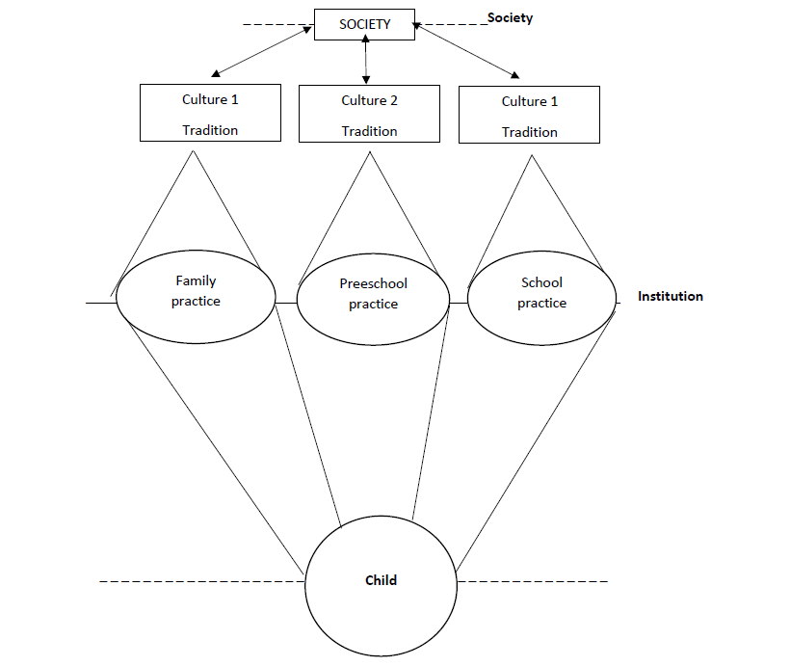
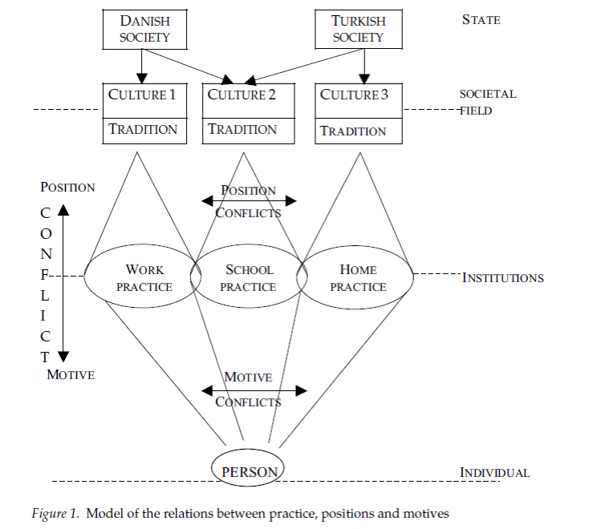
Cultural conditions for institutional practices
Figure 1. A model of children’s learning and development through participation in institutional practice.
Source: Hedegaard, M. (2009). Children’s development from a cultural-historical approach: Children’s activity in everyday local settings as foundation for their development. Mind, Culture, and Activity, 16, p. 73.
Figure 2. Model of the relations between practice, positions, and motives.
Source: Hedegaard, M. (2005). Strategies for Dealing with Conflicts in Value Positions between Home and School: Influences on Ethnic Minority Student’s Development of Motives and Identity. Culture & Psychology, Vol. 11(2), p. 189.

Slide 3
Polish parent in a Norwegian kindergarten
State/society
values
Institution
Individual
Polish parent

Slide 4
The group participating in the research
Polish parents having children in the kindergarten | 30
With vocational education | 3
With technical secondary education | 7
With higher education degree | 20
Mothers | 18
Fathers | 12
3-6 years in Norway | 9
7 and more year in Norway | 11

Slide 5
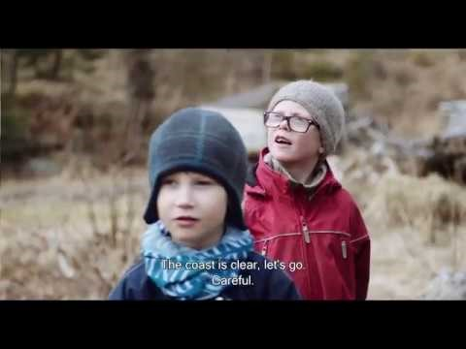
Norwegian ECE

Slide 6
The dynamics of the parental perception
First impressions | ECE voice reconstructed by the parents | Final perception
Quick food of bad quality | Food that children like and eat. National guidelines for improving food quality. | Still unhealthy, but my child likes it. More and more healthy
Poor kids are sleeping outside in the prams | Good for immune system. Healthy practice that requires care. All the children in Norway sleep outside during the day. | Healthy! Parents thankful for learning something new. It is a lot of care in putting child to sleep outside.
Limited pedagogical offer: only play and motional development in focus | Play in the Nordic Pedagogical Approach. Play as the most natural, meaningful, learning and developmental activity. | My child gets possibly to try various things regardless gender! My girls will be strong! My child get possibility to all-round development.
Children are on their own | Teachers and staff work at the 2nd plan – facilitating children’s free activities. Interventions if necessary. Social competences demand “being on their own”. | My child learns how to make friends! My child gets insight in his/her feelings and explains it to me.

Slide 7
The non-dynamics of the parental perception
First impressions | ECE voice reconstructed by the parents | Final perception
Dangerous gender practices | National guidelines for equal rights and gender policy Psychology of individual differences Health discourse | Dangerous gender practices Change of migration plan
Kindergarten is a kindergarten – what is here to talk about? | - | Kindergarten is a kindergarten Here are children, there are children

Slide 8
Meritocracy?
The kindergarten argumentation strategies reconstructed in the parental voices are about supporting parents in developing understanding to their institutional (cultural) practices.
The kindergarten is not perceived by the parents as inviting and open for conceptual/pedagogical suggestions.
At the moment in Norway:
The kindergarten teachers’ unions “use” parents and parental organisations in their own political “fights” and protests

Slide 9

https://eeagrants.org/News/2018/Invitation-to-Bid-Fund-Operator-for-the-Active-Citizens-Fund-in-Poland

