Slide 1
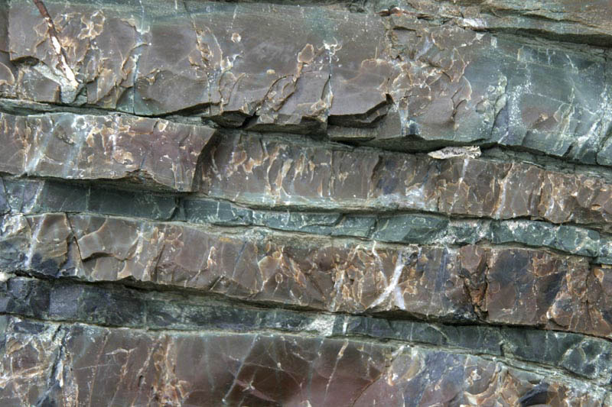
Tenderness in cases of parental public pedagogies: Why so much needed in polycrisis? 14th Biennial ERNAPE Conference: Educational Partnership between Families, Schools, and Communities Weaving vibrant alliances to empower individuals and overcome collective vulnerabilities UNIVERSITY OF VERONA, JUNE 04-06, 2025
Maria Mendel
maria.mendel@ug.edu.pl

Slide 2
Agenda
The thesis argued in the presentation
We experience fragility and vulnerability in our everyday life. It is a part of the educational, lifelong learning process involving parents. I argue that parental pedagogies – as public pedagogies regarding everyone regardless of age or social status (Biesta 2012) - are tender (cf. Mendel 2021), and this tenderness is especially desirable in the current time of crisis (cf. Dusi et al. 2022) or polycrisis (cf. Morin & Kern 1999; Tooze 2021).
The Way of Argument
The presentation of tenderness in public parental pedagogies will be based on two studies:
1/ the first focused on the well-known leader of the parental movement in Poland, Dorota Łoboda - country level (Mendel 2023);
2/ the second focused on the phenomenon of a teacher – Krzysztof Rześniowiecki - who won the Gdańsk competition for „Teacher of the Year” - local level (Mendel 2025, in press).

Slide 3
Context: POLYCRISIS
The concept of polycrisis is not new. Complexity theorists Edgar Morin and Anne Brigitte Kern first used the term polycrisis in their 1999 book, Homeland Earth, to argue that the world faces “no single vital problem, but many vital problems, and it is this complex intersolidarity of problems, antagonisms, crises, uncontrolled processes, and the general crisis of the planet that constitutes the number one vital problem" (p. 74).
South African sociologist and sustainable transitions theorist Mark Swilling then adopted the term to capture “a nested set of globally interactive socio-economic, ecological and cultural-institutional crises that defy reduction to a single cause” (2013, p. 98). Climate change, rising inequality, and the threat of financial crises interact in complex ways that multiply their overall impact (Swilling 2013, 2019).
Now, several scholars use the term polycrisis to capture the complex interactions between the Covid-19 pandemic and its fallout, Russia’s war on Ukraine, and climate change, amongst other issues. In his 2021 book Shutdown: How Covid Shook the World’s Economy, Columbia University historian Adam Tooze noted that “Polycrisis neatly captures the coincidence of different crises but it doesn’t tell us much about how they interact” (2021, p. 6). In a subsequent op-ed in the Financial Times titled Welcome to the World of the Polycrisis (2024), Tooze proposed that “In the polycrisis the shocks are disparate, but they interact so that the whole is even more overwhelming than the sum of the parts.”
https://polycrisis.org/lessons/where-did-the-term-polycrisis-come-from/ (10-05-2025)

Slide 4
Starting point:
the concept of a public pedagogy and the effectiveness of interruption
The concept of a public pedagogy based upon the premise that pedagogy – centring on the subject and education – focuses on events that take place in the public space, „between people”. What happens between people in the public space they co-create has both an educational and a political character (cf. Dewey 1916, Giroux 1998, 2003; Biesta 2012, 2014, 2017).
Such pedagogy brings up questions about the relationships that create it – relationships that “take place” (Biesta 2017, p.14-15).
Gert J.J. Biesta believes that we do not simply exists in the world, but also constantly move towards it, and it is “there” – in the public space – we establish and maintain relationships with others. These relationships co-create the public sphere/space and can be interrupted (Biesta 2012).
The result of Biesta’s thought is the confirmation of assumptions – following on from Jacques Rancière – regarding the effectiveness of interruption (in Rancière’s terms also fissures, ruptures, disruptions), that interfere with the existing public space, i.e. the current and apparently unacceptable shape of the relationships that make up the public sphere.

Slide 5
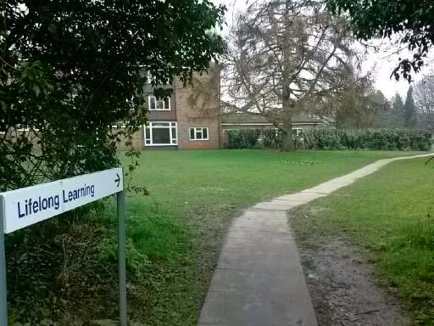
PUBLIC PEDAGOGY
involves and concerns everyone
Parents
create their public pedagogies and interrupt, and they do so in cooperation with teachers and local communities
that responds to current challenges (which may mean jointly practiced public pedagogy).

Slide 6
Relational ontology: space, affect and tenderness
Relational ontology means drawing from spatial and from affective register.
Relations (connections, entanglements, contacts, frictions with surfaces) are first and foremost spatial (they all have their places; becoming takes place) and then affective (using ability to affect and be affected).
Affect is a concept that allows us to grasp the pre-individual as shared, dynamic, and circulating; to go beyond the body and at the same time understand the changing interrelations between different bodies (and in different arrangements: human and nonhuman, nonhuman and nonhuman, etc.), images (both human and machine-made), narratives, etc. (Massumi, 2013).
I consider tenderness as a spatial and affective concept in the perspectives of both the spatial and affective turn, grounded in new readings, for example:
I live by going out into the world, not by „being” in it (Biesta);
I live by living, not by „being” (Jullien)

Slide 7
Towards new relational ontology or how to retell being: Olga Tokarczuk
In order to tell „being” in a new way (retell it) and do this with the announced reference to tenderness, I reached for the concept of Olga Tokarczuk, Polish writer and Nobel Prize winner, 2018.
Based on a kind of autoethnography regarding her own writing, Tokarczuk proposed the “psychology of the narrator” – a fascinating theory that goes beyond the framework of studies on literary work (2020: 147-179). Engaging the concept of “cimcum” from the Jewish mystical tradition, Tokarczuk generally presents the narrator as one who withdraws to make room for infinite potentiality:
Psychologically speaking, bringing a narrator into life is a process of withdrawal, shrinking - the idea is to make room and leave space for the world that must be created in order to be told (Tokarczuk 2020: 166).
Her narrator's psychology is a socio-cultural theory, responsive to the crisis time in which it was created (smth is wrong with this world). Nobel Prize winner proposes the practice of fourth-person narrative as a way to achieve a "better world" and overcome the crisis.

Slide 8
The fourth-person narrator = a tender narrator
The fourth-person narrator can be an approach according to which she steps back and gives space, "shrinks himself", let the air out of himself (which in a culture where "packing the ego" has become a great value, can be very difficult) (Tokarczuk 2020: 167).
The sine qua non condition for this withdrawal is to "see everything" carefully, to keep “perspective from where everything can be seen” (Tokarczuk 2019, part 6).
Seeing everything means recognizing the ultimate fact that all things that exist are mutually connected into a single whole, even if the connections between them are not yet known to us.
Seeing everything also means a completely different kind of responsibility for the world, because it becomes obvious that every gesture “here” is connected to a gesture “there,” that a decision taken in one part of the world will have an effect in another part of it, and that differentiating between “mine” and “yours” starts to be debatable (Tokarczuk 2019: part 6).
The fourth-person narrative is therefore learning responsibility for the entire common world; an education towards the practice of "seeing everything" and a lesson in being responsible for "everything".
Such a narrative is extremely demanding, but possible when the narrator is tender to this "everything seen"; when s/he is a tender narrator.

Slide 9
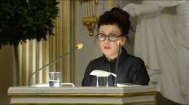
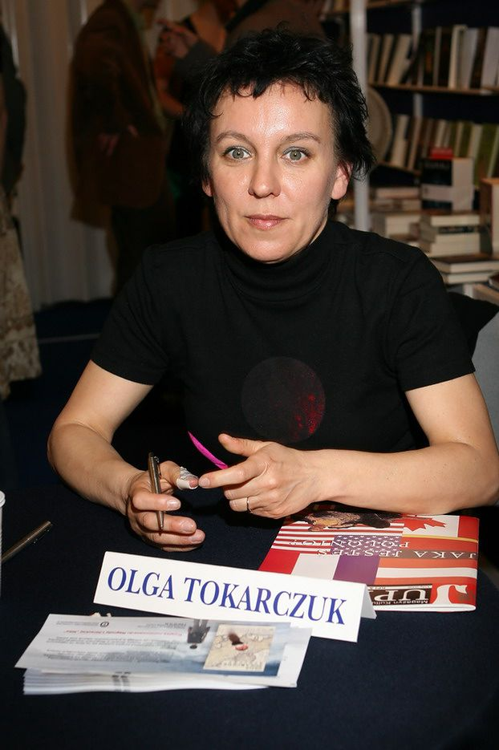
TENDER NARRATOR: A SENSITIVE RADAR When as a little girl I would look at that picture, I would feel sure that my mom had been looking for me when she turned the dial on our radio. Like a sensitive radar, she penetrated the infinite realms of the cosmos, trying to find out when I would arrive, and from where (…)
– Tokarczuk began, and then added that thanks to her mother’s tender practice,
she..
I understood then that there was more to me than I had ever imagined before.
And that even if I were to say, “I’m lost,” then I’d still be starting out with the words “I am”—the most important and the strangest set of words in the world.

Slide 10
Tenderness
I have to take a close look at each thing and person, with the greatest solemnity, and personify them inside myself, personalize them. That is what tenderness serves me for - because tenderness is the art of personifying, of sharing feelings, and thus endlessly discovering similarities.
Tenderness is the most modest form of love. It appears wherever we take a close and careful look at another being, at something that is not our “self”.
Tenderness is spontaneous and disinterested; it goes far beyond empathetic fellow feeling.
Instead it is the conscious, though perhaps slightly melancholy, common sharing of fate.
Tenderness is deep emotional concern about another being, its fragility, its unique nature, and its lack of immunity to suffering and the effects of time.
Tenderness recognizes the bonds that connect us, the similarities and sameness between us. It is a way of looking that shows the world as being alive, living, interconnected, cooperating with, and codependent on itself.
(Tokarczuk, 2019; 2020)

Slide 11
On research design: Methodological points
The research on which I base my argument consists of two case studies (2020, 2023), both of which use narrative interviewing (individual and group) and document analysis.
Keeping the qualitative perspective of this study, I focused on achieving a description well-grounded in the obtained material.
My main goal:
to describe the generalized experience of the research subjects’ educational and political activities in the public space;
to present an image expressing what striving for the common good and democratic equality in a common space looks like.
Key-question: Do the respondents interrupt the relationally understood public space and, if so, in what way (how, in what places, etc.)?
Cf. Mendel 2023; 2025 (in press)
In arguing my thesis, I use the results of these two case studies: I find in them confirmation of the tenderness that characterizes public parental pedagogies.

Slide 12
Case 1. Dorota Łoboda the mother of two daughters and a well-known leader of the parents’ grass-root movement
The „Parents Against Education Reform” movement brings together over a million participants, active in various parts of the country and protesting in various forms against the reformist actions of the current government, including withdrawing the decisions of previous governments on the three-cycle education system as part of compulsory schooling (instead of the 6-year primary school, 3-year lower secondary school and 3-year high school, return to the 8-year primary school and 4-year high school), or starting school education from 6 the year of life.
Dorota Łoboda also runs the "Parents Have a Voice” foundation as president.
She is also active in the feminist movement, being a member of the Program Council of the nationwide organization "Congress of Women".
For a second term of office - a councilor in Warsaw.
In the last elections she was elected a member of the Polish parliament.

Slide 13
FINDINGS Education, politics, and a fragile community – towards resistance
I felt that the influence of parents was insufficient, and we as parents can offer the school a lot and make it a more child-friendly place. And this is where it all started. (…) I had a feeling that our fragile community, which had somehow managed to cope with in my daughters’ school, would simply collapse under the pressure of what our authorities had prepared for us, and I was deeply convinced that these schools would change for the worse after the reform (…).
Parents in this movement have consolidated themselves against decisions taken at the political level, which organize the life of schools and change society in a controversial direction. Despite the fragility of the parental community, resistance became the primary basis of this movement. Loboda and other parents (manifesting being in alliance with teachers) interrupted the existing public space; there were the fissures, ruptures, that interfered with this space.
How this interruption looked like?
And this social activity of mine also entered some wider waters then, I started to organize demonstrations. And then it somehow so naturally turned out that I would be running for the local government election somewhere, because this role of an educational activist and social activist actually led me to the wall, because it ends somewhere, right?

Slide 14
Case 2. Krzysztof Rześniowiecki The high school art teacher and „Teacher of the Year” in Gdańsk, 2023
(…) he is not only a teacher and school pedagogue, but actually he is a spirit that integrates us, the school. How does he do it? He has an extraordinary ability to write. I don't know if you know, he is from Wikipedia. Students always laugh that "We have to meet the gentleman who wrote Tabaluga", it is a movie fairy tale for which he wrote the lyrics. (…) He does not admit it, but he wrote a lot of lyrics for fairy tales, for various songs. So even sometimes when we have a quiz about school and it is "Who wrote the song in Tabaluga?", well, they all know that it is Rześniowiecki. So when we have, for example, any celebrations at school (…), it is: "Krzysiu, write us something". Less than two hours pass and Krzysiek comes out, well, almost with a poem! (…) Krzysiek is simply invaluable! (…) And everyone knows him too. As I said, everyone passes through his hands. And all parents pass through him. When we ask about a student, he always knows, he knows the name, he's like, "Oh, yes, yes. This parent wrote to me. I wrote about this." It's just... well, that's... a personality! (...) he's probably an absolutely outstanding personality (Interview with the school principal).

Slide 15
FINDINGS Rześniowiecki’s Tenderness, Disagreement and Interruption: The Bridge
I came up with a name („The Bridge", MM) so that it would sound something.
But when the pandemic came and the lockdowns started (...) well, you know...
And a specific conversation, even a phone conversation, hearing someone's voice, is somehow much more valuable than typing away on a keyboard.
I had to come up with something.
I decided to use my database, I have such an accessible database of parents who put their phones there themselves, to make daily screening calls, I don't know, to 2 or 3 people from each class, to parents of students from each class, to ask them how they are doing, how the parent and student are coping, how the family is coping, how they are feeling, what their condition is, what they would possibly expect from us, etc.
And I always encountered such a very friendly reflection from the parents. They were happy that someone was interested in them, I even heard in one conversation "You are the only teacher who even asked how we are feeling. Because even in this stationary school such questions have never been asked".
And that gave me the courage to hold this Bridge, to send these signals to parents that we are here, that we are living teachers, that we think about you, that if something happened, have the courage to call or communicate.

Slide 16
FINDINGS Rześniowiecki’s Interruption as Inspiration: Let's get to know each other, let's do something together
Recently, Mr. Rześniowiecki said (…) that parents should share their hobbies. For example, they send links and we know where these parents perform at concerts. So it is like this that we also know something more about these parents (…) This helps us a lot in our work (Interview with the school principal).
Thanks to Rześniowiecki, the school has adopted the idea that everyone exhibits in exhibition spaces: students, parents, teachers, it is normal. The school gallery sometimes goes beyond the school, and sometimes comes to the school from outside. It is mainly the parents who organize themselves here and as a result, both the school and the city have a richer calendar of artistic and cultural events. But all of these are initiatives or inspirations from Rześniowiecki (paraphrase: group interview).

Slide 17
DISCUSSION and CONCLUSIONS
Dorota Łoboda and Krzysztof Rześniowecki interrupt and they do it basing on their belief of the constant possibility of an educational interruption, through actions resembling the staging of their own disagreement, by introducing “an incommensurable element”, that “can act both as a test and as a reminder of publicness” (Biesta 2012 p.697).
In a constant interest in subjectivity, Łoboda as a parent, and Rześniowecki as a teacher, seem to develop the public pedagogy of interruption (Biesta 2012; 2013; 2017). Their interruptions manifested their tenderness – first – and then their disagreement with – like in the thought of Biesta - the “egological” form of existence focused on the individual self (cf. Biesta, 2017, p.14). Living together in tenderness they overcame the egological way of being together in a public space. They made their interruptions into a socially shared activity, encompassing a wider environment than the one closest to them. Their actions:
demonstrated the ability to spread and disseminate;
they became an inspiration for other teachers, other parents, students and local communities;
they contributed to the joint construction of a better public space for all.
Final conclusion:
Parents interrupt and they create their tender public pedagogies. They do so in cooperation with teachers and local communities. It is also the case that it is a teacher - like Rześniowecki - who inspires tenderness in the public parental pedagogies (which may mean jointly practiced public pedagogies).

Slide 18

Thinking at the end about a tender narrator: Towards the fourth-person narratives
Let's repeat: a tender narrator is someone who can include both the perspective of each of the characters and the ability to go beyond the horizon of each of them, who sees more and more broadly, who sees everything.
A tender narrator speaks in/for the interest of the shared, common space. This is an expression of commonality in the community: the all elements of this space are there in a meaningful way while retaining their full rights and independence and acting out of concern for the fragile common good that is being together.
Their narrative becomes the “fourth-person narrative” that suspends the first-person narrative – but not their own self, because only in their own self, through the lens of their own experience and logic can they make room for the other and really be together in really common world (just like the inmates living in one room, shared, common room).

Slide 19
Thank you very much :)
maria.mendel@ug.edu.pl
www.en.ug.edu.pl

Slide 20
References
Biesta, G.J.J. (2012). Becoming Public: Public Pedagogy, Citizenship and the Public Sphere. Social and Cultural Geography 13(7), 683-697.
Dusi, P., Addi-Raccah, A., Mendel, M. (2022). Crises time: an opportunity to rise up against injustice and structural inequalities. Fighting alongside parents for a better world through new forms of school-family co-participation. Encyclopaideia – Journal of Phenomenology and Education. Vol.26 no. 63 (2022) https://doi.org/10.6092/issn.1825-8670/15175
Fisher, M. (2010). Capitalist Realism: Is There No Alternative? Winchester, UK: Zero Books
Jullien, François (2009), Transformation silencieuses, Éditions Grasset & Fasquelle
Jullien, François (2017), Une seconde vie: Commencer véritablement ďexister, Éditions & Fasquelle Grasset
Jullien, François (2023), Rouvrir des possibles: dé-coïncidence un art ďopérer, Éditions de ľObservatoire/Humensins
Mendel M. (2021): Art. As a Tender Public Pedagogy / Sztuka jako czuła pedagogika publiczna, in: Sławomir Lipnicki (Ed.): Metafiguracje. Omdlenie / Metafigurations. Fainting, Gdansk: Academy of Fine Arts, pp.: 68-79
Mendel, M. (2023). Parental public pedagogy: A Polish leader about being together, where action is possible and freedom can emerge. International Journal about Parents in Education, 13. https://doi.org/10.54195/ijpe.16412
Mendel, M. (2025). Tender public pedagogy: We are the fragments in more-than-human figurations of public space. Research in Education, in press.
Nobel speech by Olga Tokarczuk, The Nobel Foundation 2019, 14 https://www.nobelprize.org/uploads/2019/12/tokarczuk-lecture-polish.pdf
Tooze, Adam (2023): Interview, edited transcript of Adam Tooze’s interview for Radio Davos: https://www.weforum.org/stories/2023/03/polycrisis-adam-tooze-historian-explains/ (Accessed 14 Dec 2024)
The Global Risks Report 2023, 18th Edition. World Economic Forum https://www3.weforum.org/docs/WEF_Global_Risks_Report_2023.pdf

